Slide 1
Machine Learning Part 2
AI Inspire Workshop @ PRC

Slide 2

Basic Statistics Concepts

Slide 3
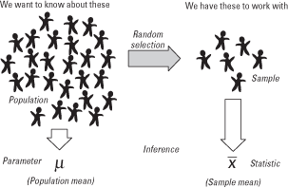
Populations and Samples
Choose sample representative of population
Census : interview entire population
Expensive
Unethical
Too much time
Not practical

Slide 4
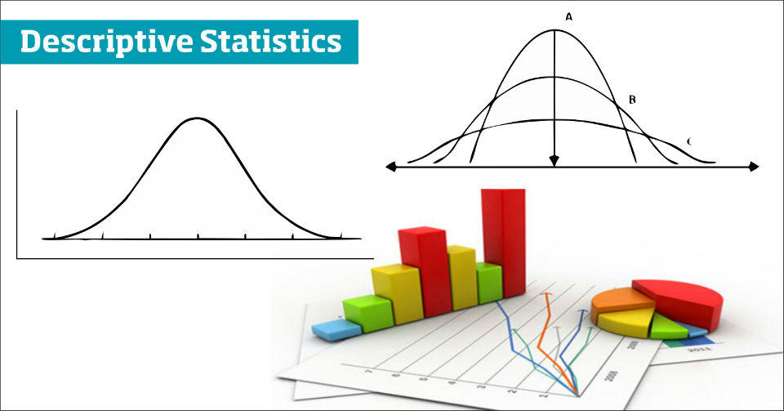
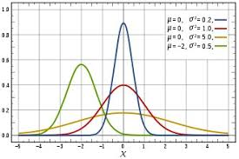
2 Main Types of Statistics
Descriptive Statistics
Collect, present + describe data
Inferential Statistics
Draw conclusions + make decisions based on sample data

Slide 5
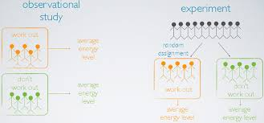
Types of Observational Studies
Cross sectional study
Collected at one particular instant of time
Retrospective study
Collected from past
Prospective study
Collected from future

Slide 6
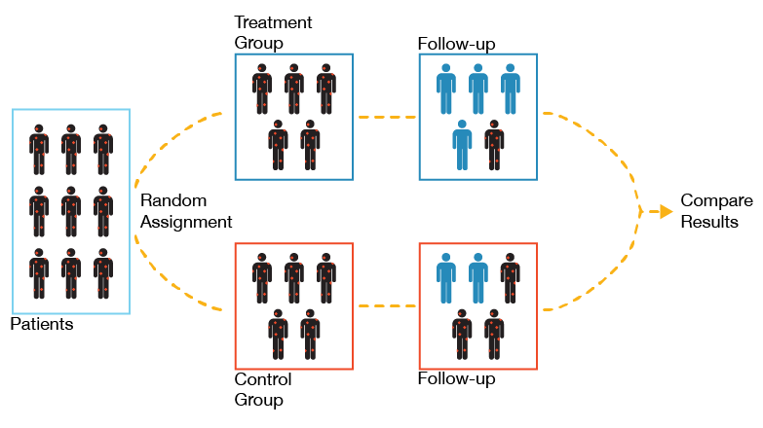
Types of Experimental Studies
Lurking variables can be controlled
Randomized controlled experimental studies
Blind studies
Participants not aware of which group they are place in
Double blind studies
Both participants and researchers are unaware of groups

Slide 7
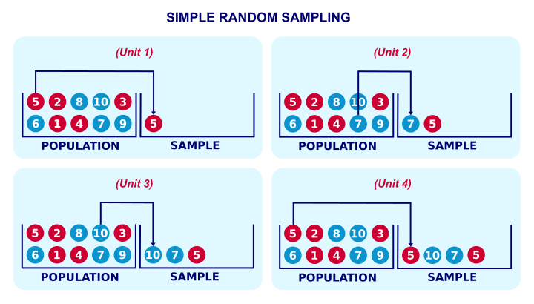
Simple Random Sampling (SRS)
Most commonly used
All subjects are = likely to be selected in sample
RULE : If sample is representative of the population, data collected from sample can be used to make inferences of population

Slide 8

Types of Bias
Sampling Bias
Bias in sample
Selection bias
Only asking particular group of people to be in sample, instead of randomly sampling (selection bias)
Voluntary response bias
Only people with strong opinions will voice opinion
Amazon reviews
Wording deliberate bias
Framing question, confusing questions
Wording unintentional bias
Without knowing, unsure of bias in questions

Slide 9

Categorical vs. Numerical Data
Categorical
No numbers
Nouns, words
Categories
Numerical
Number based

Slide 10
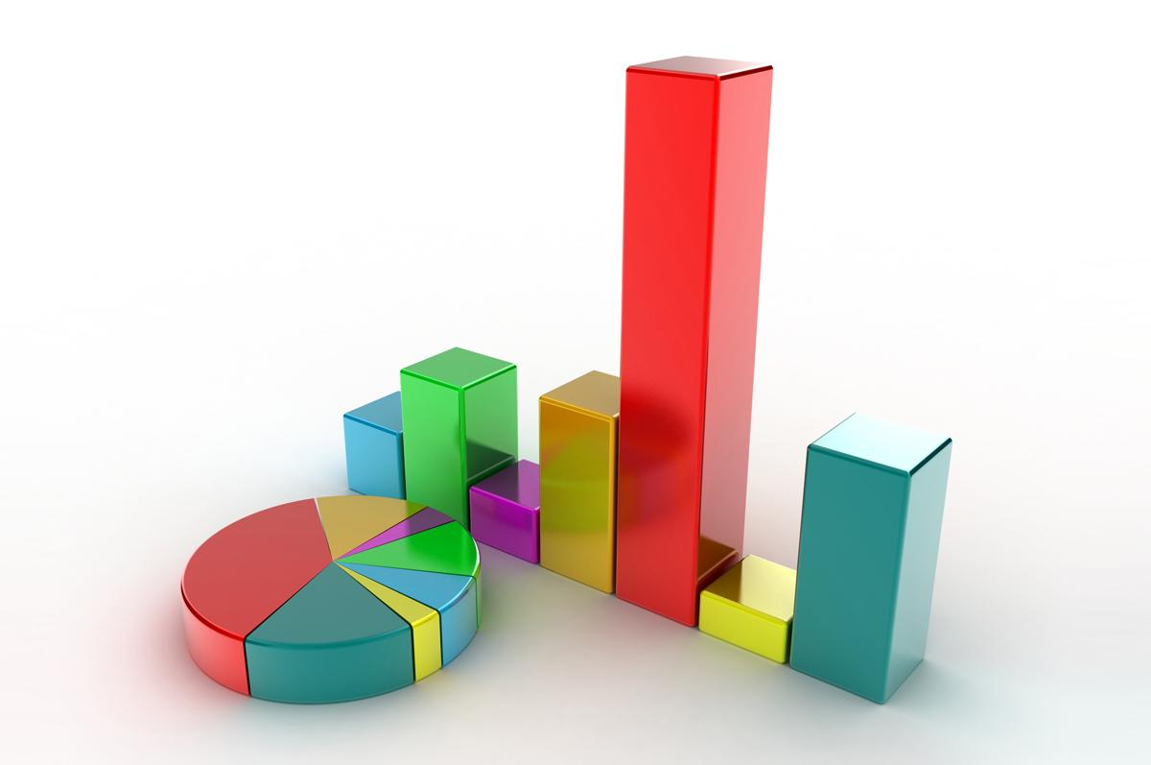
Representing Data Visually
Frequency table
Divide into different intervals and measure relative frequency of each interval
Dot plot
Relationship between 1 variable
Scatter plot
Relationship between more than one variable
2 variables

Slide 11
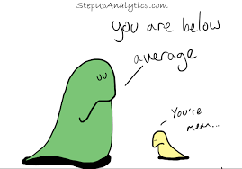
Overview of Measures of Central Tendency
Mean
Sum / number of elements
Strongly affected by outliers
Most common measure of central tendency
Median
Middle number in ordered list
Not affected by outliers
Resistant/Robust measure

Slide 12
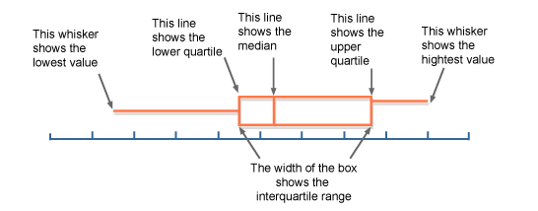
Location Measures
Quartiles
Split data into 4 = sized groups
IQ = Q3 - Q1
Q2 = Median
Box and whisker plot

Slide 13
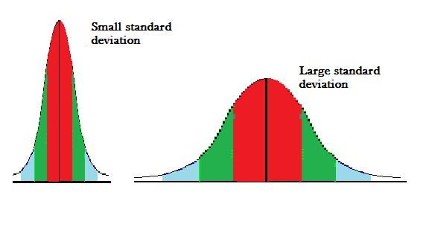
Dispersion
Spread/variability of values in data
Range
Max - min value
IQR measures dispersion
MAD (Mean Absolute Deviation)
Variance
Standard Deviation

Slide 14
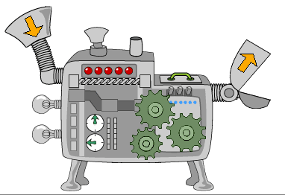
What is a ML algorithm?
Y = f(X), maps input variable X to output variable Y

Slide 15
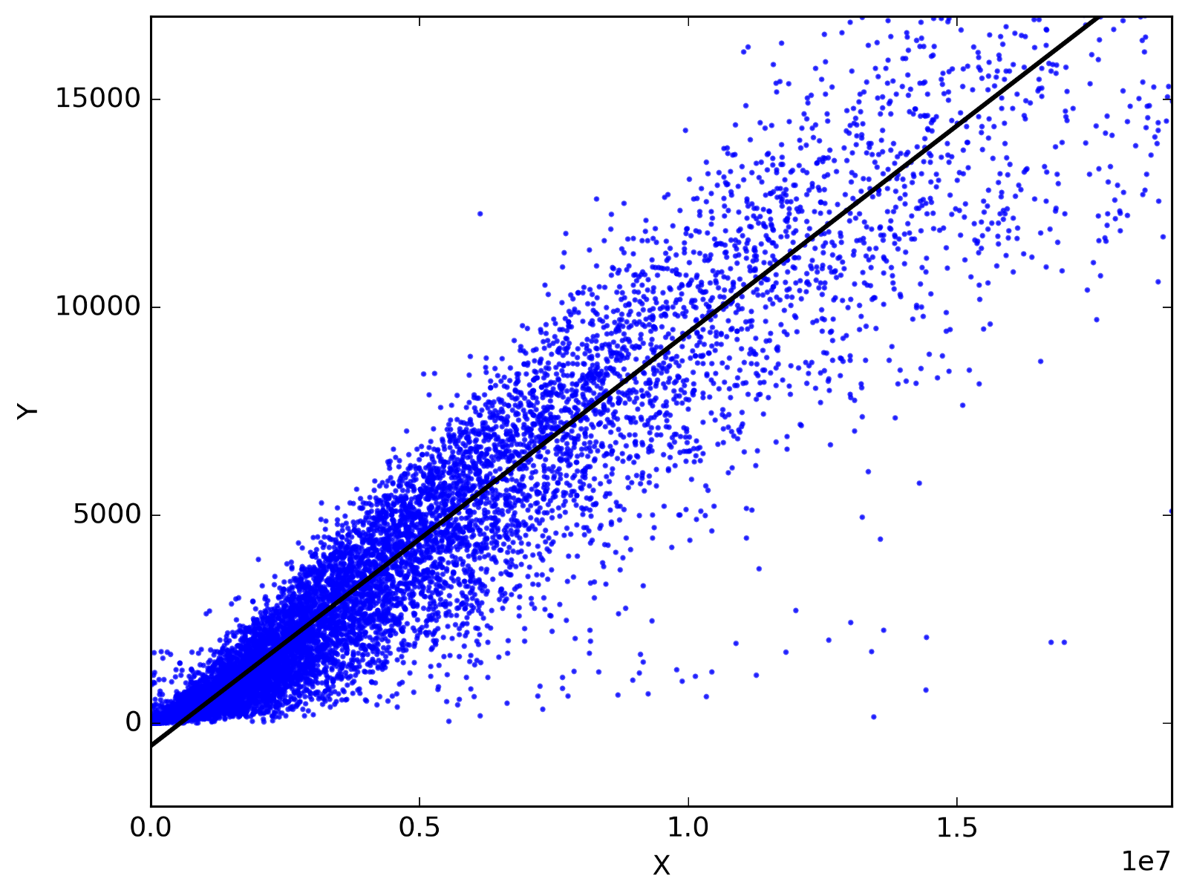
Regression Algos

Slide 16
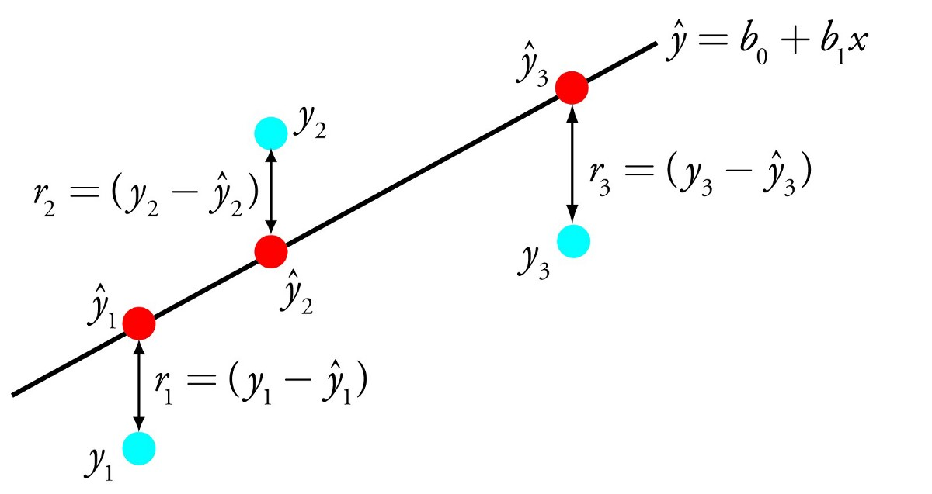
Linear Regression
Predictive modeling
Minimize error
Most accurate prediction
Line which fits relationship
Input (X) with Output (Y)
Residuals
Difference between predicted fit of line and actual

Slide 17
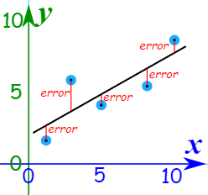
Least Squares Regression
Find total of squares of errors as small as possible
Least squares
Straight line ⇒ min. Sum of squared errors

Slide 18
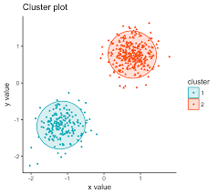
Clustering Algorithms

Slide 19
K-Means Algorithm
Partition n observations into k clusters
Choose which cluster each observation goes to based on nearest mean

Slide 20
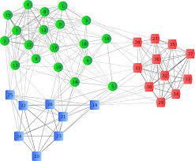
K-Medians
Partition n observations into k clusters
Choose which cluster each observation goes to based on nearest mean
Less sensitive to outliers

Slide 21
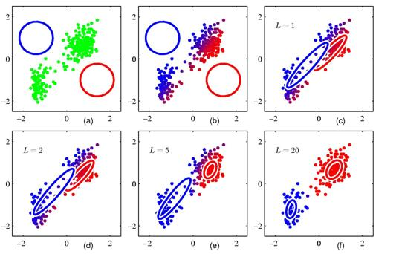
Expectation Maximization
Generates best hypothesis for data
Max. prob. Of data that comes from k distributions, with particular mean and variance

Slide 22
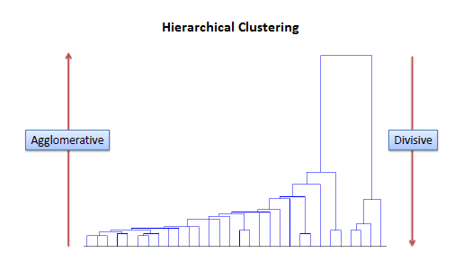
Hierarchical Clustering
Build hierarchy of clusters
2 most similar clusters are combined
Produces a tree

Slide 23

Association Algorithms

Slide 24
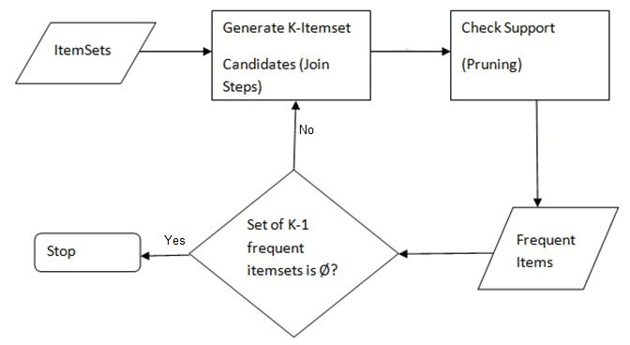
Apriori Algorithm
Data mining algorithms
Find relationships and associations in data
Identify frequent individual items
Operate on databases
Uses breadth-first search

Slide 25
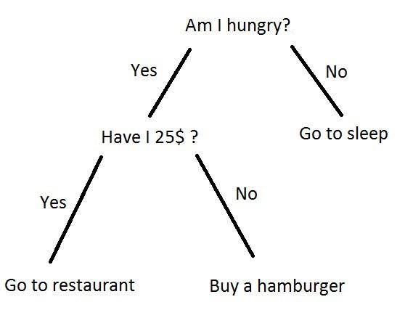
Decision Tree Algorithms

Slide 26
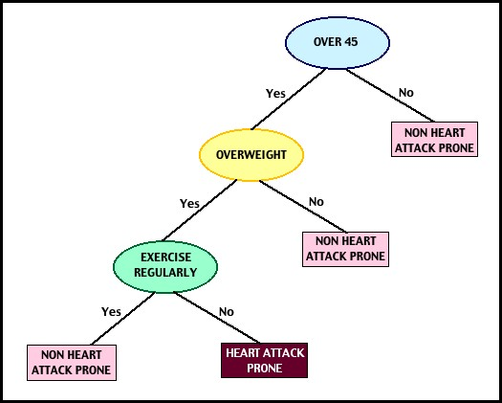
Classification and Regression Tree (CART)
Uses set of rules and decisions to decide outcome of event
Regression model fitted to each node/vertice
Gives predicted values of Y

Slide 27
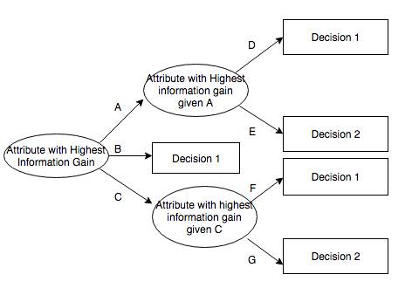
Iterative Dichotomiser 3 (ID3)
Ross Quinlan
Generate decision tree from data
Selects best attribute for each iteration
Can overfit data, not always optimal

Slide 28
Bayesian Algorithms

Slide 29
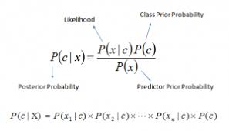
Naive Bayes Algorithm
Classification technique
Centered around probability

Slide 30
Thank You!

